Slide 1

1 Month Presentation
Nuno Leitao
10/01/2019

Slide 2







Agenda
1. About me
2. Why I'm here at Honda?
3. What have I been doing at Honda?
4. Honda initial impressions
+Honda
-Honda/chances of improvement/what could have been done differently
5. Quiz
Uigradients
fontawesome

Slide 3











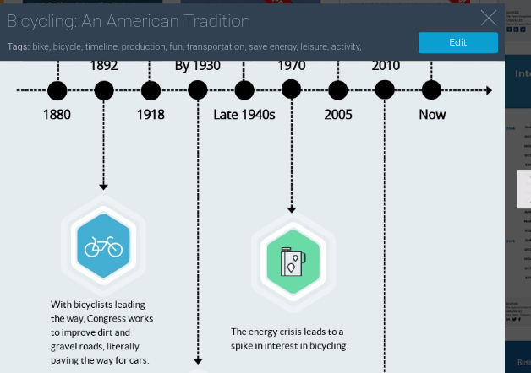








2007
Year abroad
Supply Chain Management
2015
Series Planning Engineer
Process improvement
Quality concerns
Process documentation
Mulsanne F1
Bentayga Consoles, Unit Dash Trim and build
2012
Product engineering
Kaizen supervisor
Project manager
2011
Logistics intern
Process engineering
2003-2009
Bsc Indu
MSc Indu
1985
2009
Sales

Slide 4




Why I'm here at Honda?
Automotive/Technology
Data

Slide 5
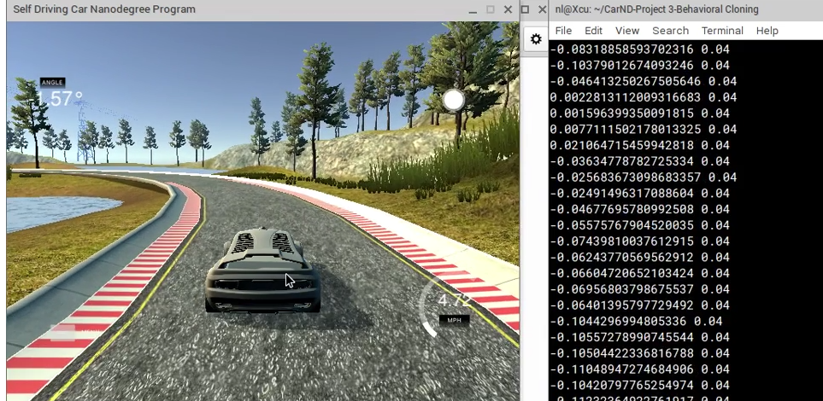

Slide 6



26 November 2018
Plastic Operations
Shadowing…
Learning Hub
Updating/locking gentanis
Supporting Taro 2VM
Supporting Core meeting/ML reviews
Neil's job? How to phrase it? Impact of Xrate?

Slide 7
4. Honda initial impressions
+Honda
-Honda/chances of improvement/what could have been done differently
HR
Learning Hub (specially to a starter)
Booklet Caroline Roberts
Acronyms list from Donna
Not a best time for starting… just before X-mas, James (manager was in Japan.. Then on holidays…)
What about a more formal 1 month schedule… to avoid situations like what/who should I do today… just spend a full day with a person.
Flexi-time could be .. More flexible.. Instead of daily .. Could be monthly/yearly because work is never balanced/even -> save on overtime
No brews @ desk?... For example engineering next doors they have…

Slide 8
True/False
Maybe some of them are all True.. maybe all false...

Slide 9
a) Played basketball against Grammy winners
b) Leitão means piglet in Portuguese
c) I only had 1 piece of bacon in my life
d) I was an extra in a Bollywood Movie

Slide 11
a) Played basketball against Grammy winners
b) Leitão means piglet in Portuguese
c) I only had 1 piece of bacon in my life
d) I was an extra in a Bollywood Movie
a) 2007, Arcade Fire
b) Portuguese word
c) FALSE. Love Bacon! Best thing about Britain
d) “Welcome Back” (4.2 IMDB)

